Slide 1



How computers and programming work
https://xkcd.com/353/

Slide 2
What will we learn?
Programming - the process of creating a computer program Basics of Programming (Python) How to get your computer to do what we want How to divide and conquer any problem Automate the boring stuff!

Slide 3
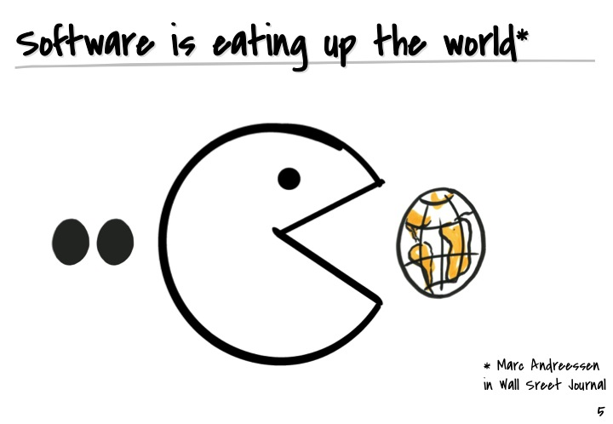
Programs eat up the world

Slide 4

Data

Slide 5
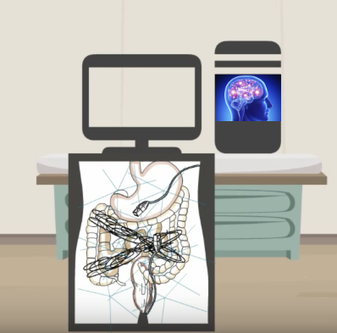
Computer = obedient child(but particular)

Slide 6
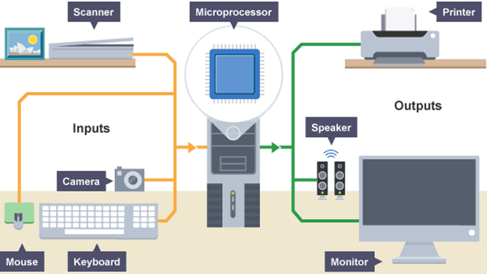



... digest everything we feed

Slide 7
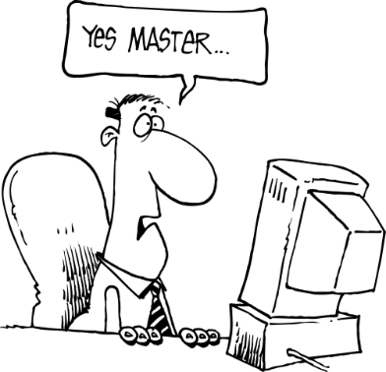
How to talk to the computer?

Slide 8
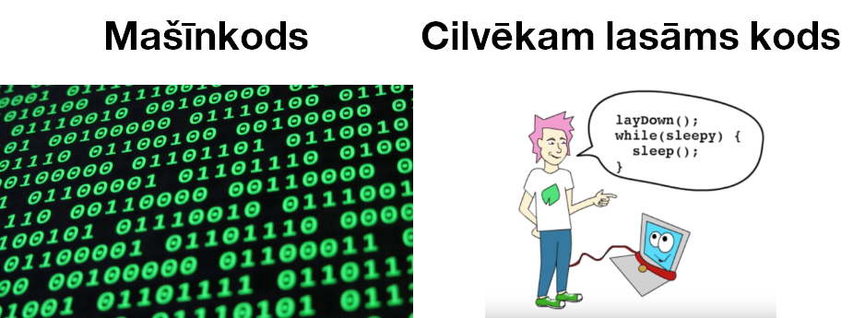
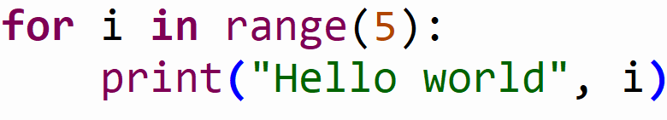
“Welcome to The Matrix”

Slide 9

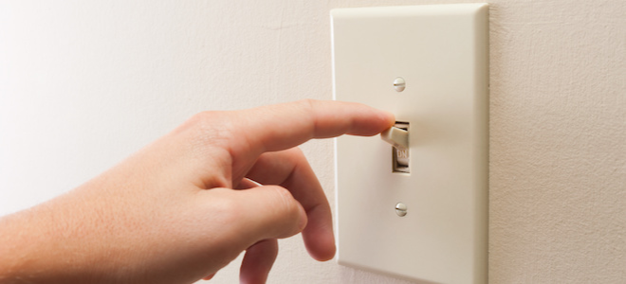
Abstraction

Slide 10
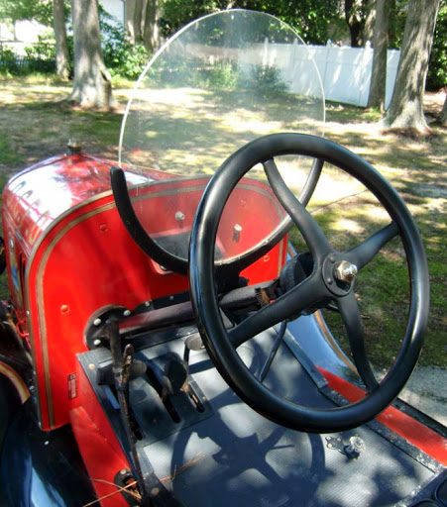
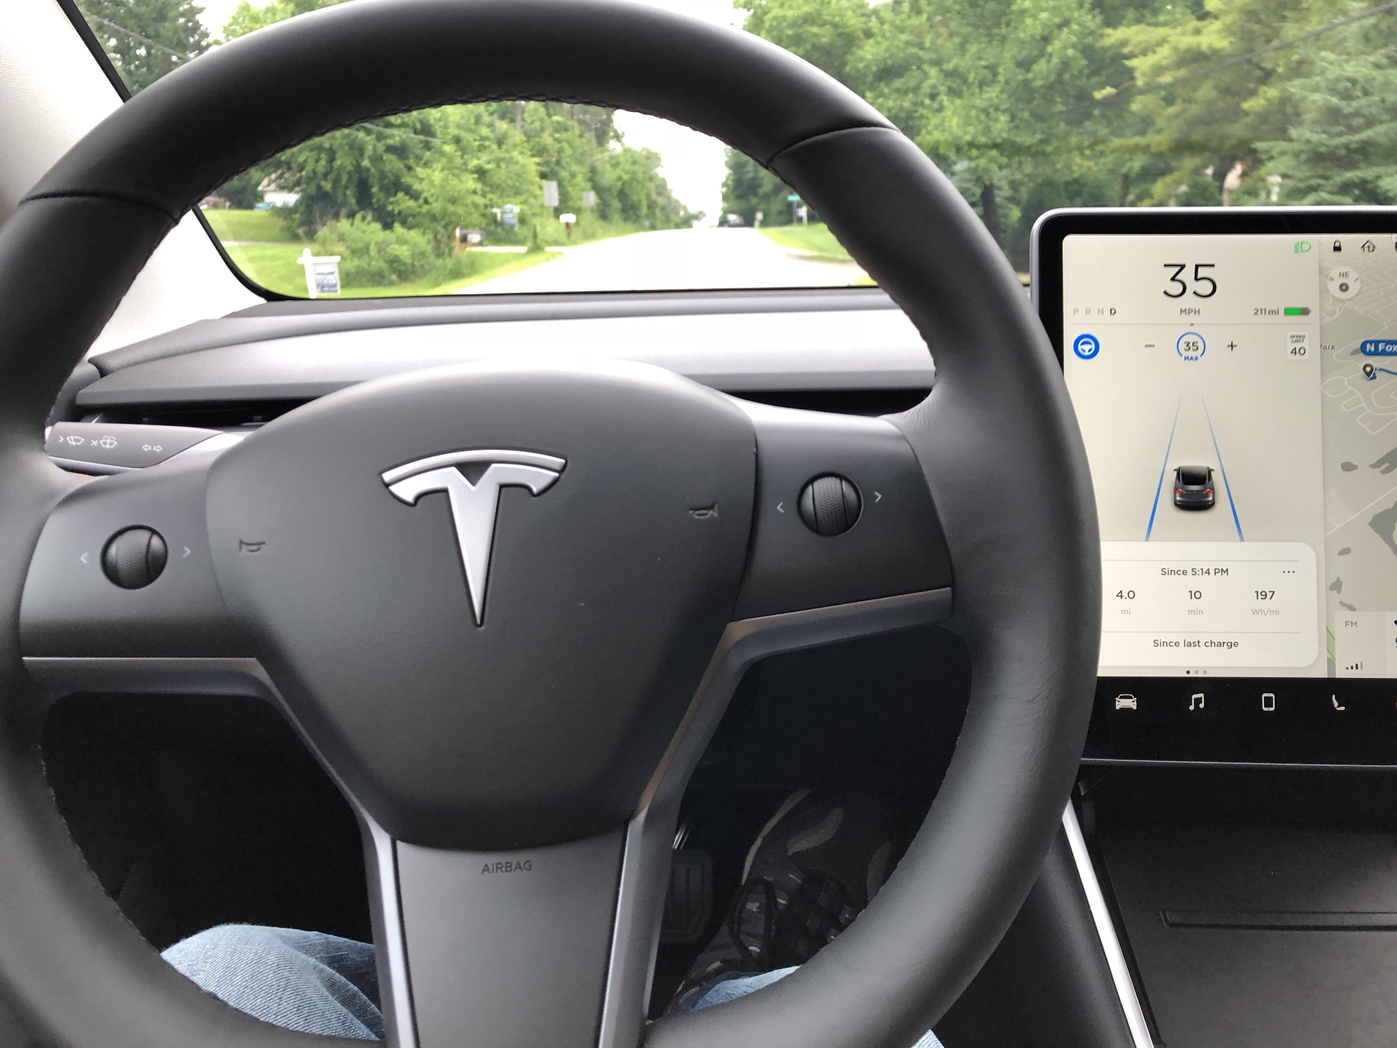
Abstraction

Slide 11
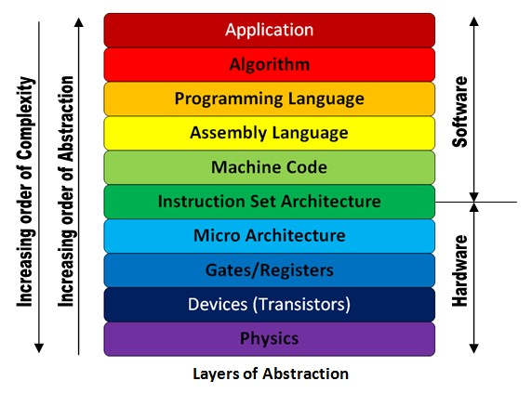
Abstraction

Slide 12
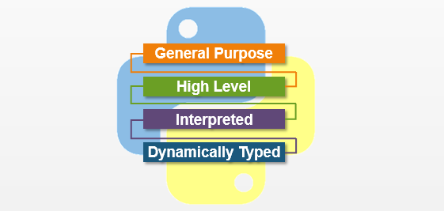
Python language

Slide 13
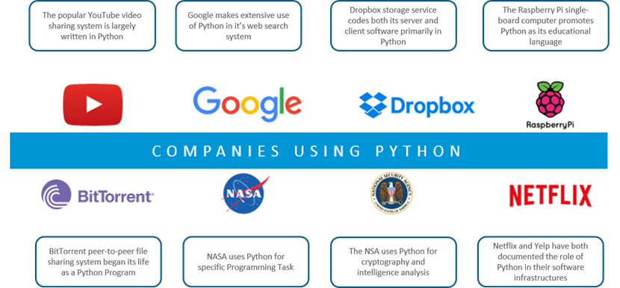
General

Slide 14
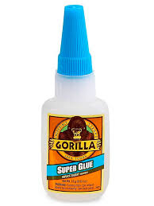
General Glue Language
Readable
Interactive
Interpreted
Dynamic
Object-oriented
Portable
High level
Extensible in C++ & C

Slide 15
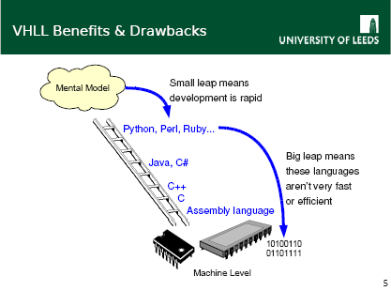
High-level

Slide 16
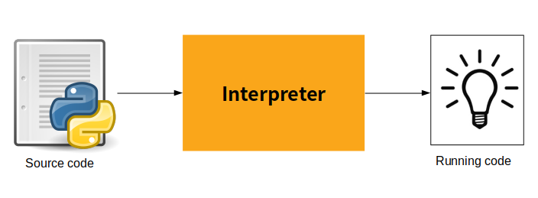
Python interpretators
indianpythonista.wordpress.com

Slide 17
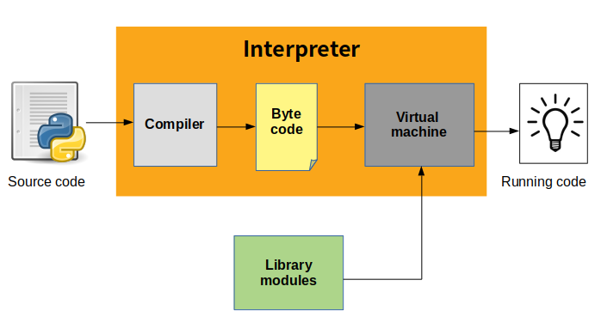
Python interpretators
src: indianpythonista.wordpress.com

Slide 18
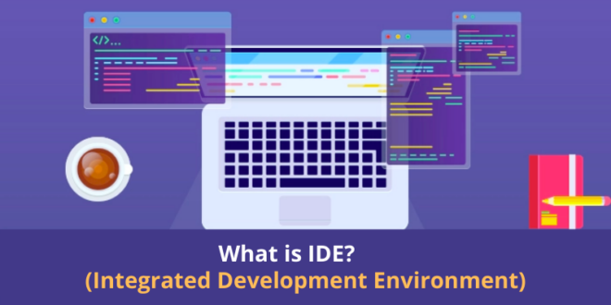
Izstrādes Vide

Slide 19
Name How you got here Experience What you want to achieve
R

